Slide 1



Slide 2

Trendsys: Sentimental Analysis Using Feature Selection
Group Members:
Tahira Jabeen (FA16-BCS-057)
Muneeba Arshad (FA16-BCS-044)
Supervised by:
Miss Tahira Sadaf
Presented on 27th July,2020
Department of Computer Science
COMSATS University Islamabad, Attock Campus

Slide 3
Outline
_______________________________
Introduction
Problem statement
Objectives
Methodology
Modern tools
Project Completion Steps
Project Implementation
Future Work
References
_______________________________

Slide 4
Introduction
_______________________________
Extracting overall sentiments of products reviews in form of graphs
Extracting aspects based sentiments by classify these reviews into polarities(positive, negative, neutral)
Website help customers in selecting the top quality product
_______________________________

Slide 5
Problem Statement
_______________________________
Problem of finding a quality product in online store
How to judge the particular product against desire aspect
Represent overall and aspects based sentiments graphs of products.
_______________________________

Slide 6
Objectives
_______________________________
Display result of Top ranking product on the basis of aspects.
Help User to find the quality product.
_______________________________

Slide 7
Methodology
_______________________________
Agile Development Methodology
Specification, Design, Implementation and Testing are inter-connected
Result Decide in Advance
Customer Involvement
System Accept Modification
_______________________________

Slide 8
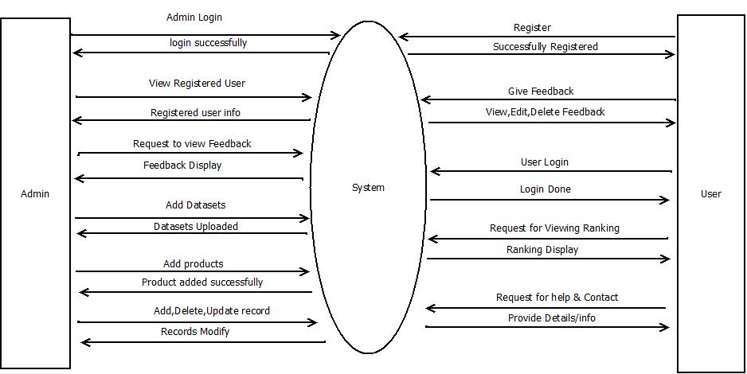
Data Flow Diagram
_______________________________
DFD Level 0
_______________________________

Slide 9
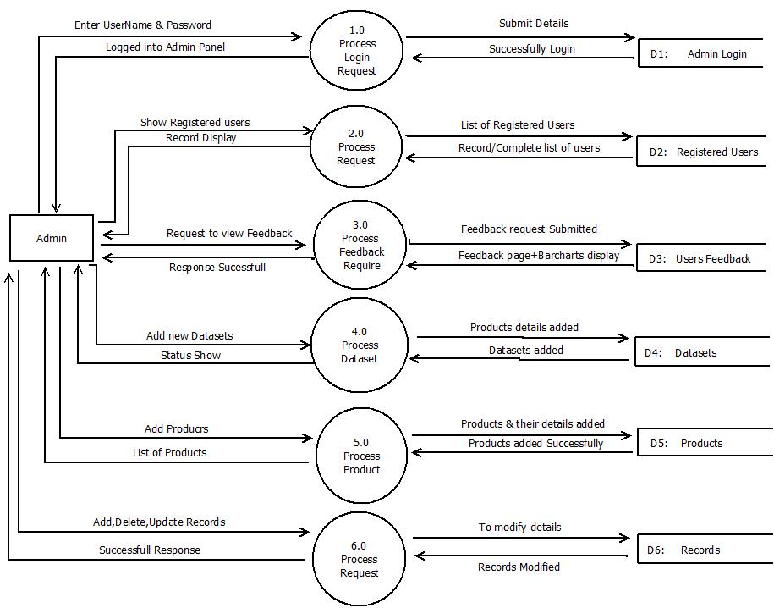
Data Flow Diagram
_______________________________
_______________________________
DFD Level 1 (Admin)

Slide 10
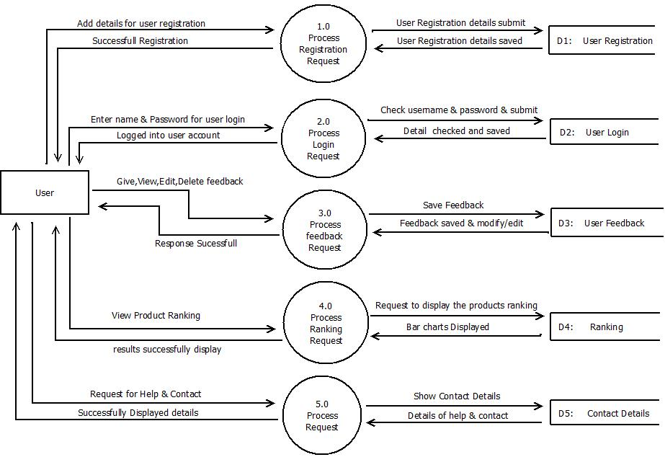
Data Flow Diagram
_______________________________
______________________________
DFD Level 1 (User)

Slide 11
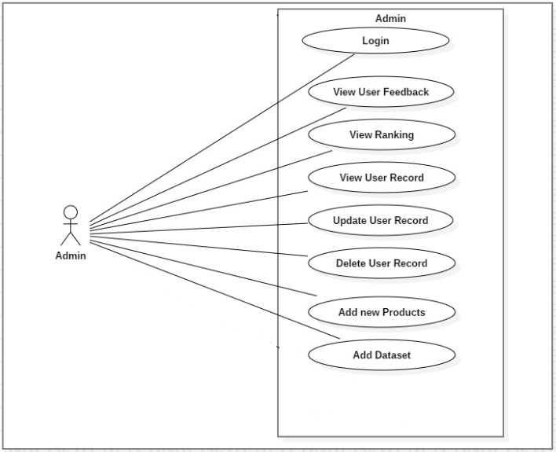
Use Case Diagram
_______________________________
_______________________________
Admin Use Case diagram

Slide 12
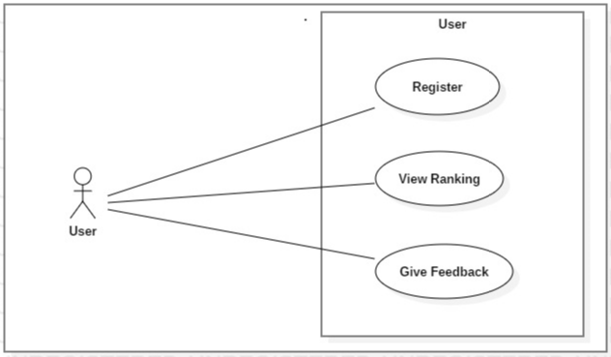
Use Case Diagram
_______________________________
Server Use Case diagram
_______________________________

Slide 13
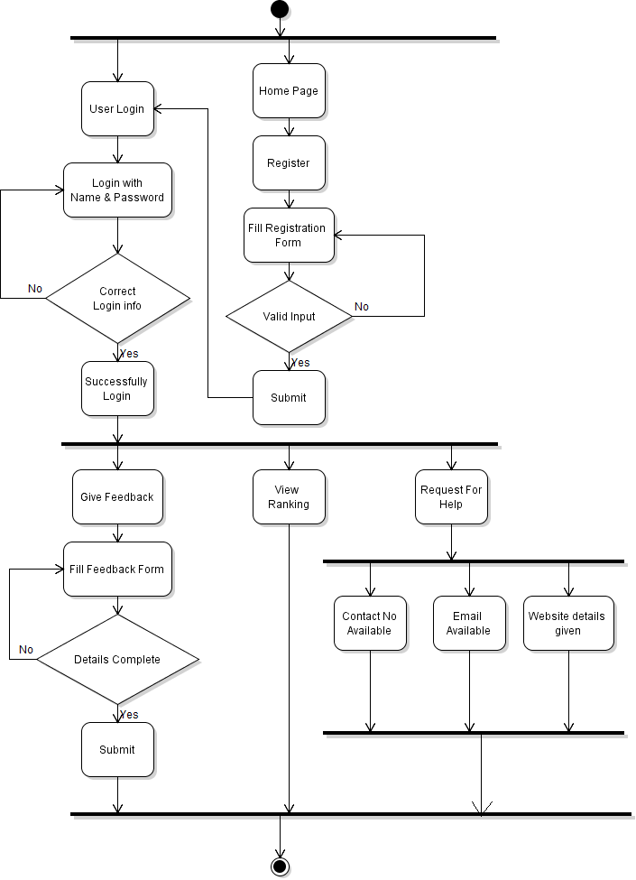
Activity Diagram
_______________________________
_______________________________
User Activity Diagram

Slide 14
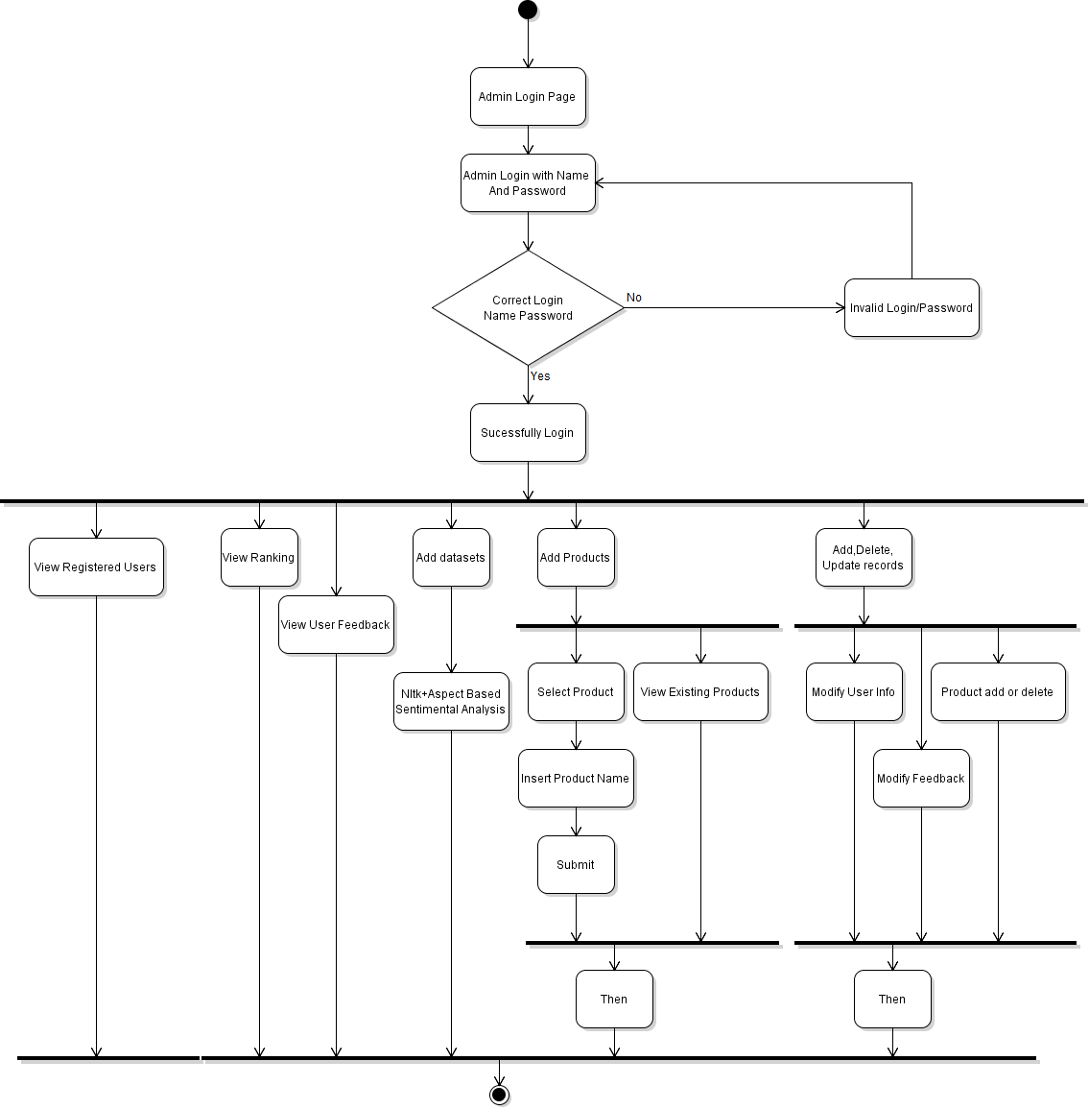
Activity Diagram
_______________________________
_______________________________
Admin Activity Diagram

Slide 15
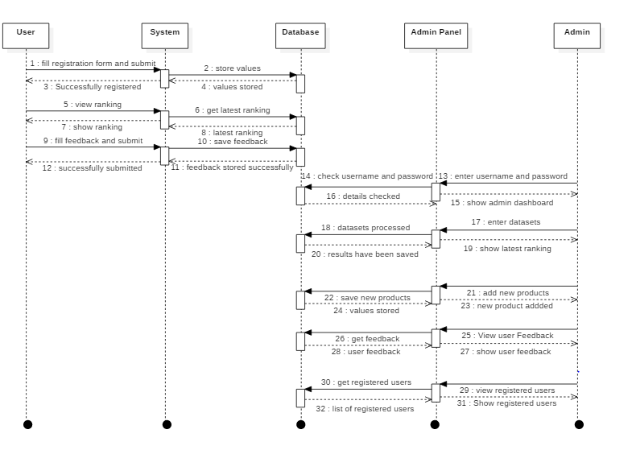
Sequence Diagram
_______________________________
_______________________________
Sequence Diagram

Slide 16
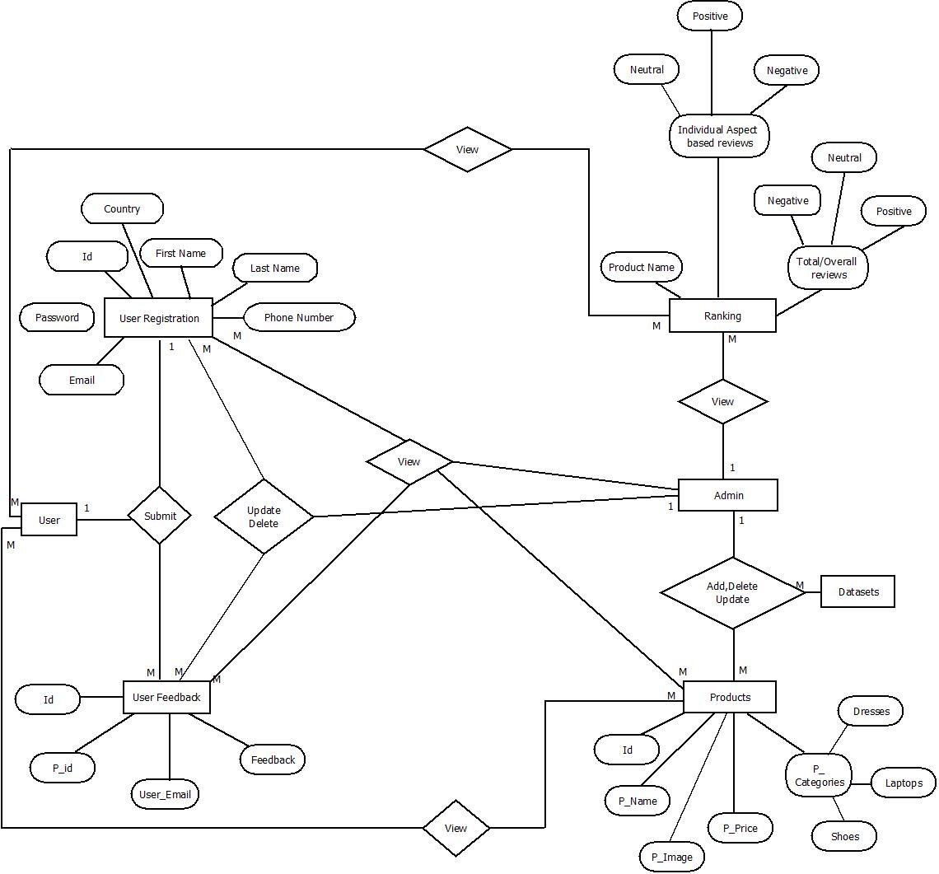
Entity Relationship Diagram
_______________________________
_______________________________
ERD Diagram

Slide 17
Modern Tools
_______________________________
Technologies:
PHP
Python
CSS
Tools:
Jupiter Notebook
JavaScript
JQuery
Star UML
MS Word
MS PowerPoint
Bootstrap
HTML
Sublime
Modern Tools
_______________________________

Slide 18
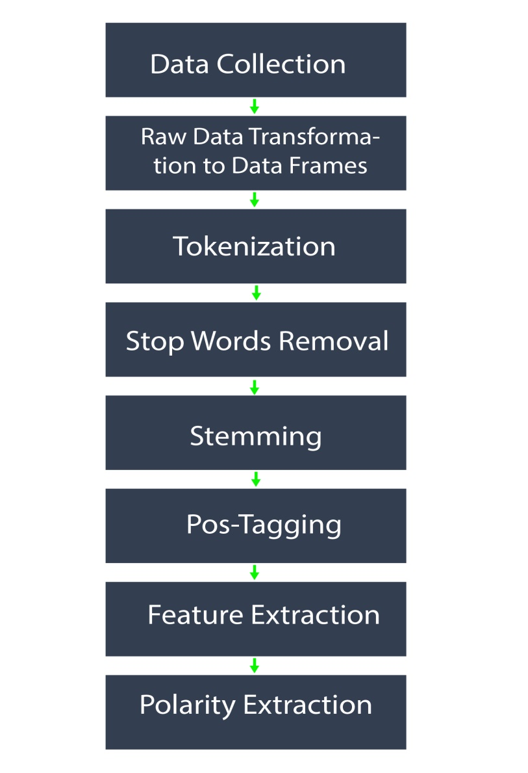
Project Completion Steps
_______________________________
_______________________________

Slide 19
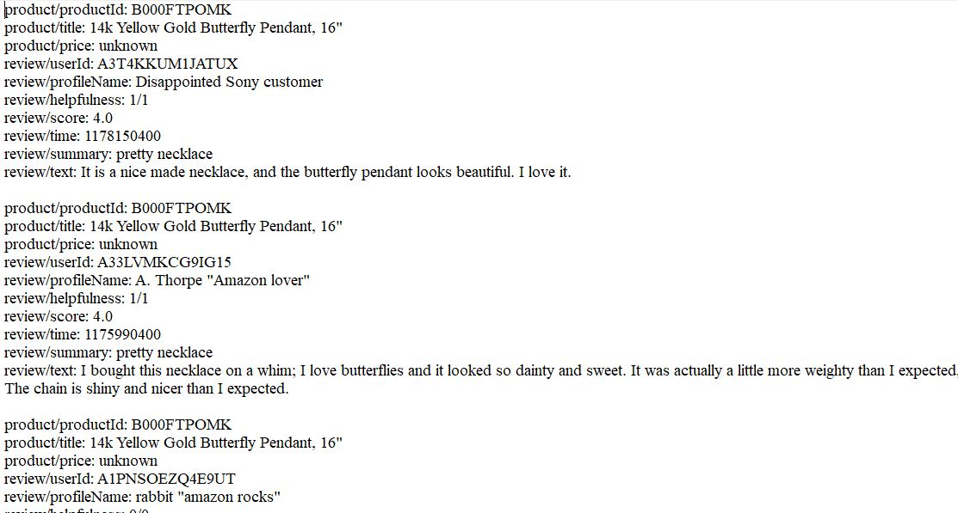
Data Collection
_______________________________
Datasets:
We collect textual data from different datasets to analyze product reviews of different brands. Datasets picked from websites including UCI Repository, Kaggle, Amazon etc.
_______________________________

Slide 20
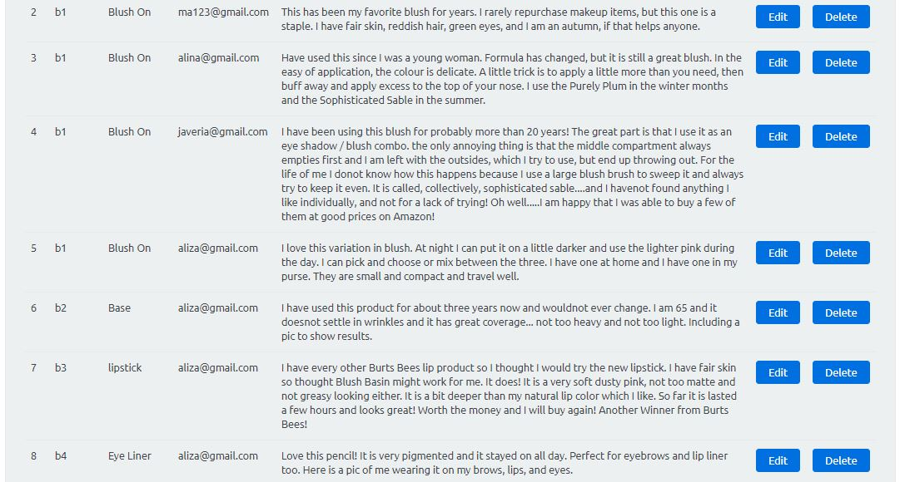
Customer Feedbacks
_______________________________
User Feedback:
We can also get textual data about products from customer reviews/feedbacks. More, User must login to website before giving feedback. Once user give feedback against any product, the user email and feedback store in feedback table in database.
_______________________________

Slide 21
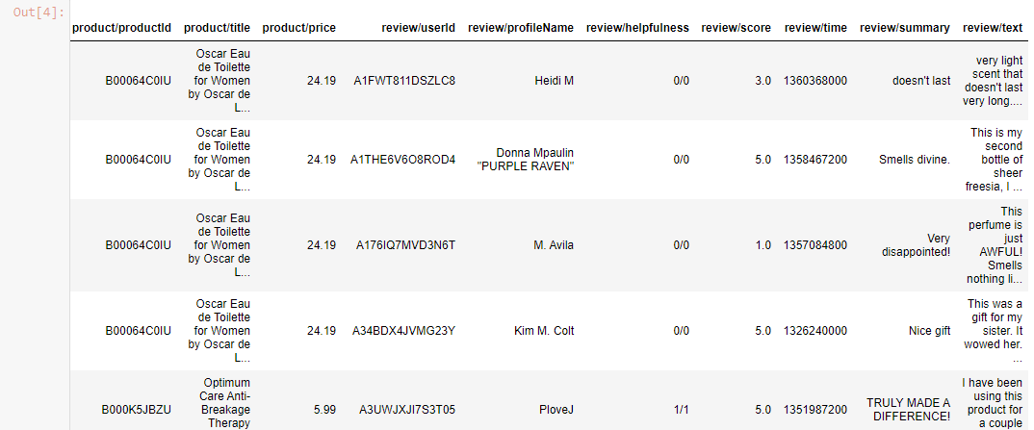
Data Transformation
_______________________________
Raw Data to Data Frames
_______________________________

Slide 22
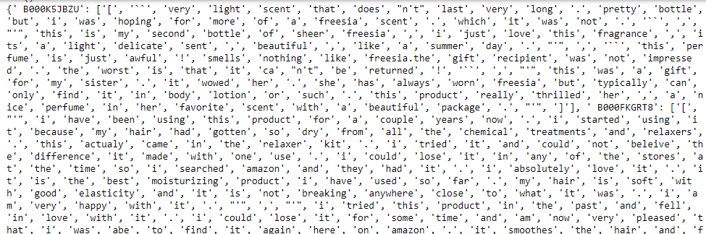
Tokenization
_______________________________
_______________________________

Slide 23
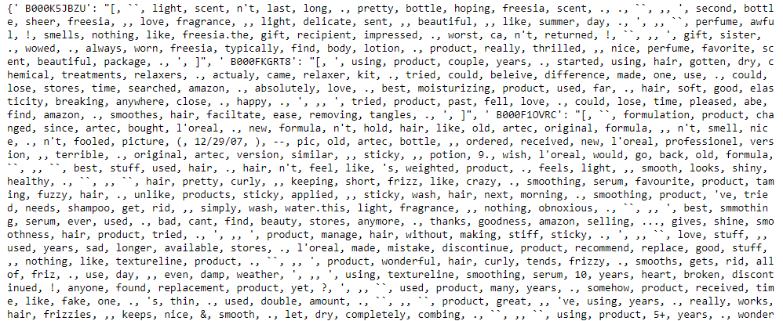
Stop Words Removal
_______________________________
_______________________________

Slide 24
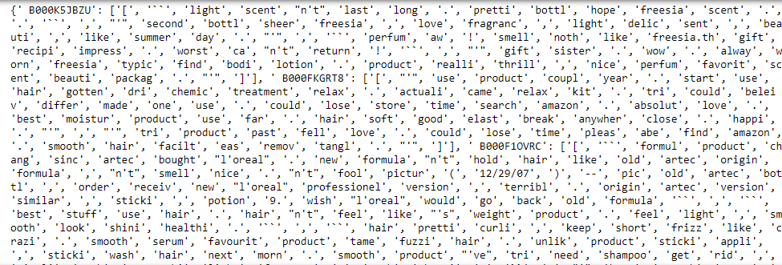
Stemming
_______________________________
_______________________________

Slide 25
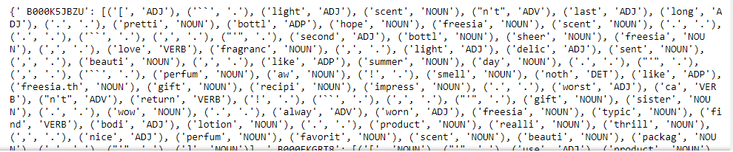
Pos-Tagging
_______________________________
_______________________________

Slide 26
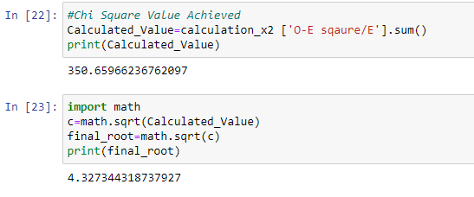

Feature Extraction (Chi-Square)
_____________________________
Formula:
X^2= ((Observed Frequency-Expected Frequency)^2) / Expected Frequency
_______________________________

Slide 27
Cont.…
_____________________________
Algorithm Steps:
Finding Observed Values(Frequency of each aspect)
Sum of all rows against each column.
Sum of all columns against each row
Find expected values
Apply chi-square formula
Result found
_______________________________
27

Slide 28
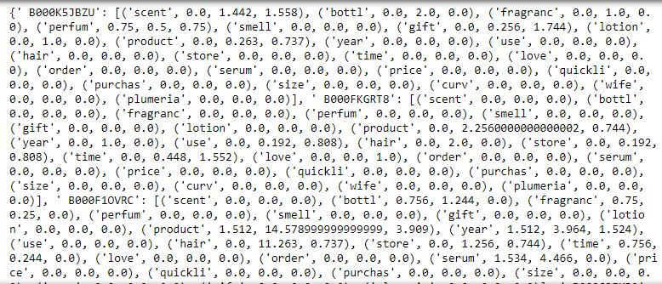
Polarity Extraction
_______________________________
_______________________________

Slide 29
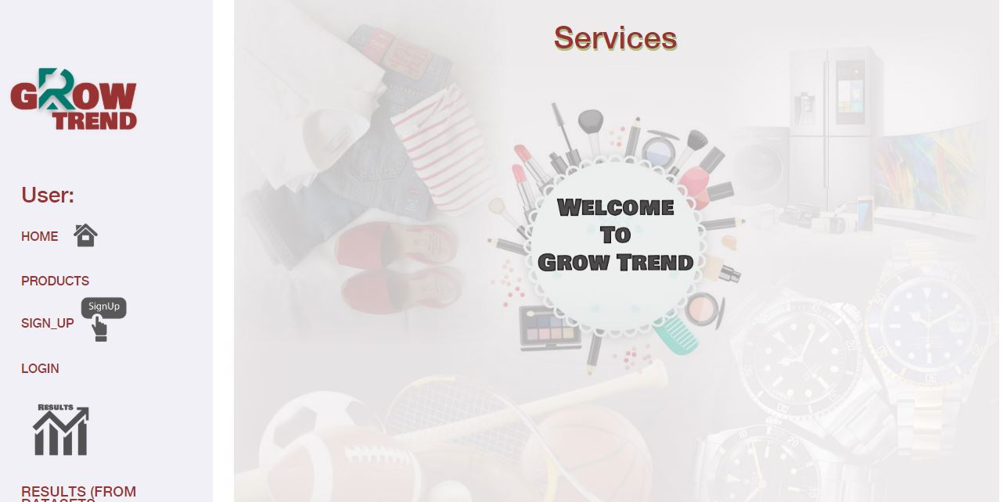
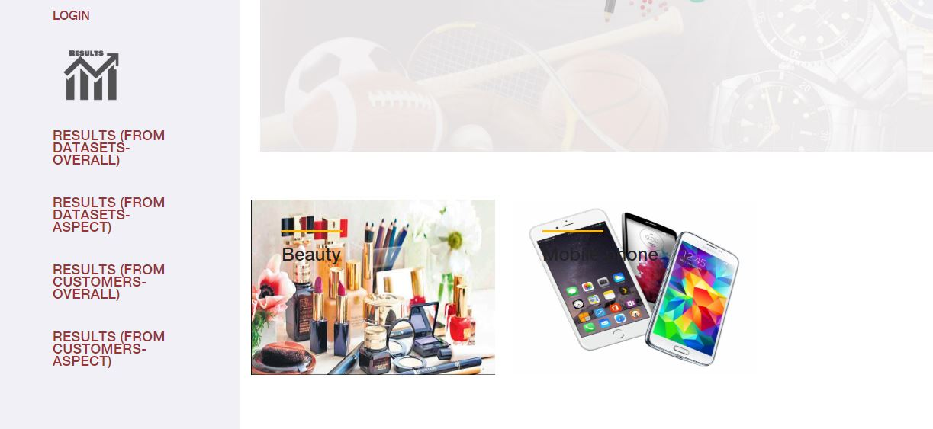
User Interface
_______________________________
_______________________________

Slide 30
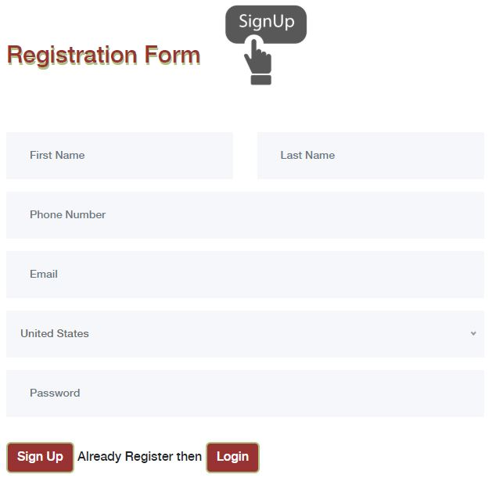
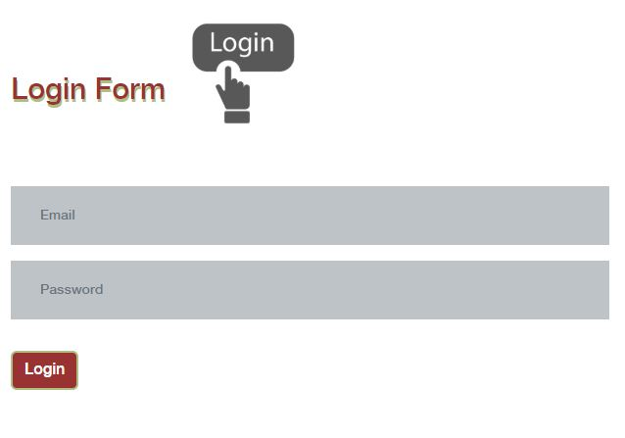
User Interface
_______________________________
_______________________________

Slide 31
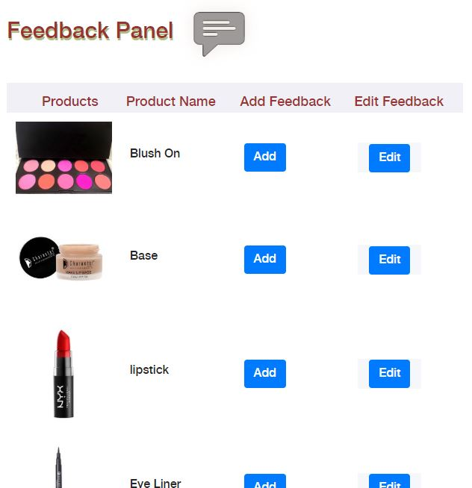
User Interface
_______________________________
_______________________________

Slide 32
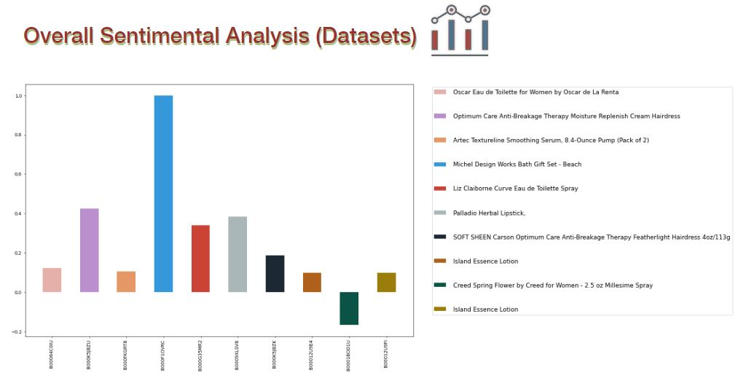
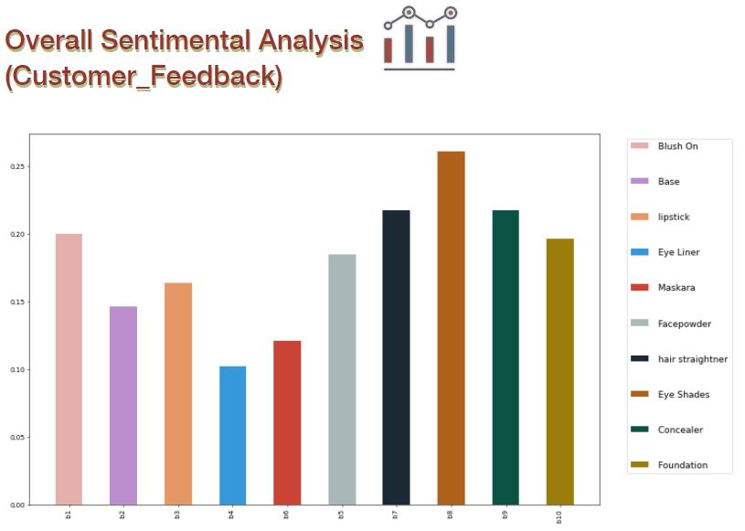
User Interface
_______________________________
_______________________________
32

Slide 33
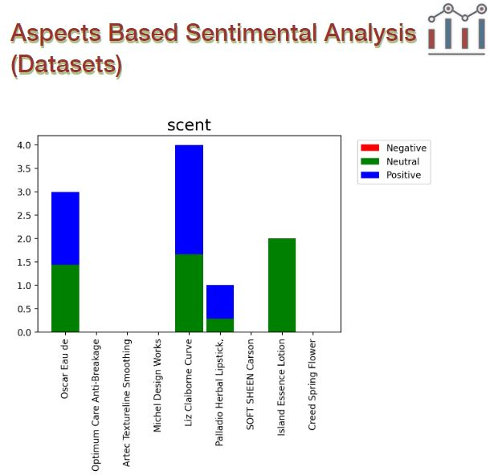
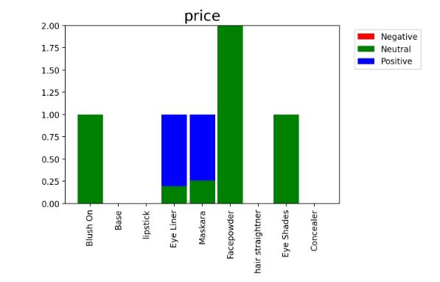
User Interface
_______________________________
_______________________________
FYP Proposal Presentation
33
33

Slide 34
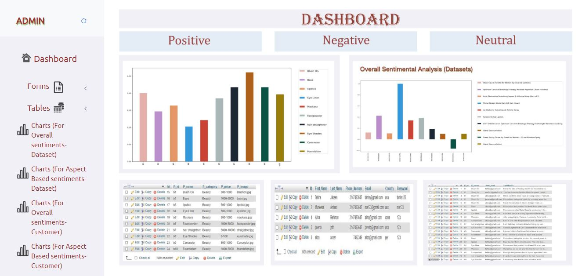
Admin Panel
_______________________________
_______________________________
FYP Proposal Presentation
34
34

Slide 35
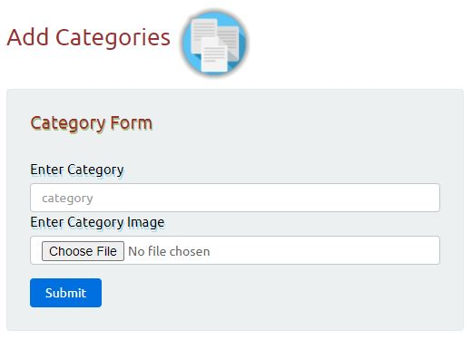
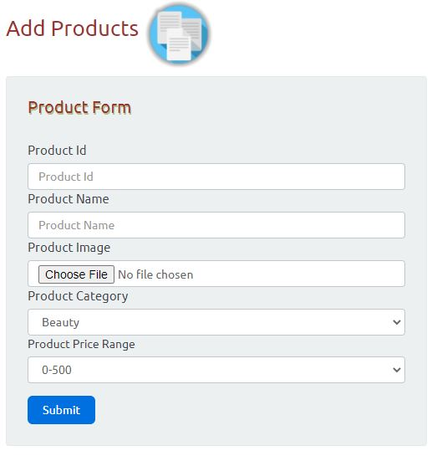
Admin Panel
_______________________________
_______________________________
FYP Proposal Presentation
35
35

Slide 36
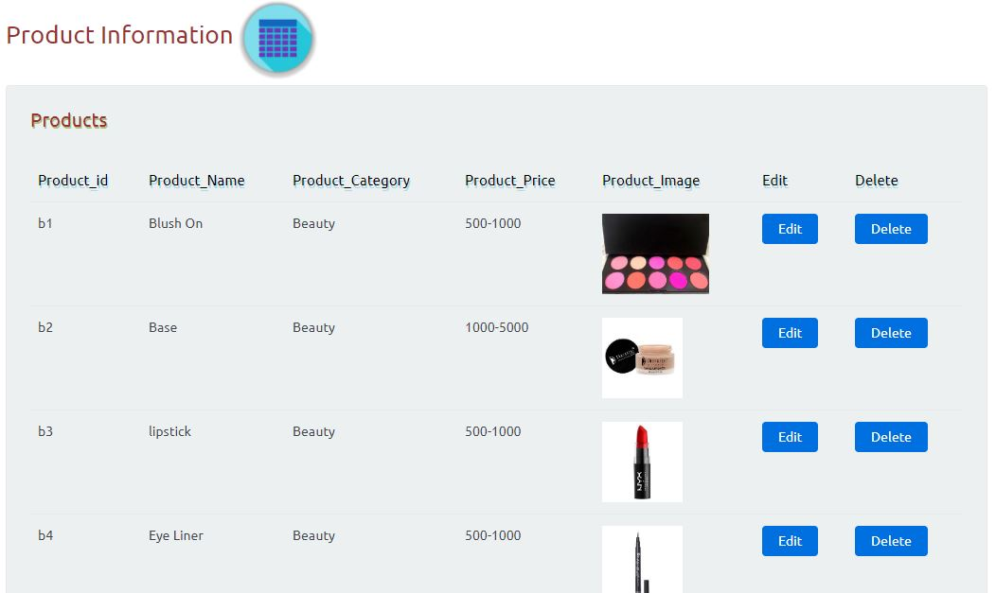
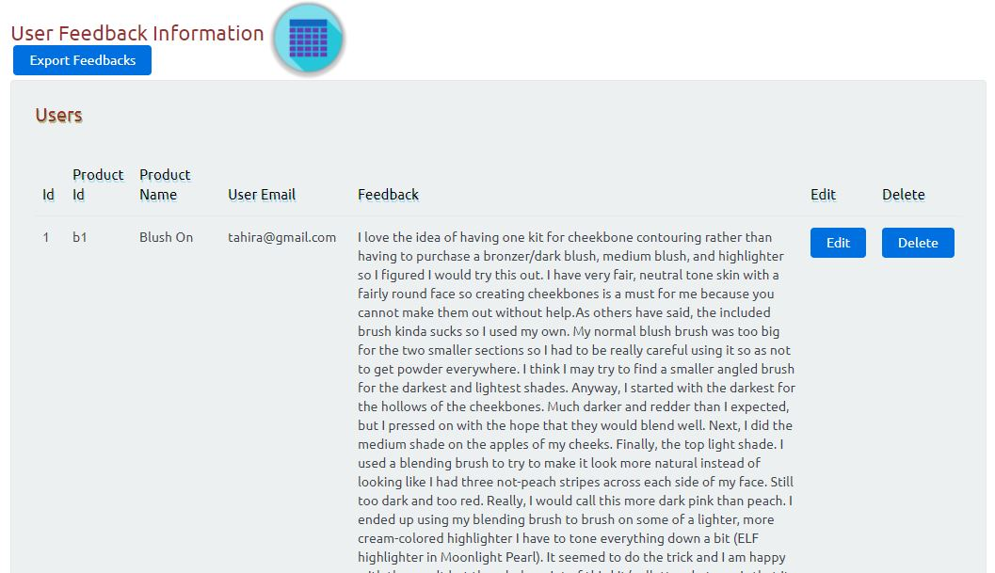
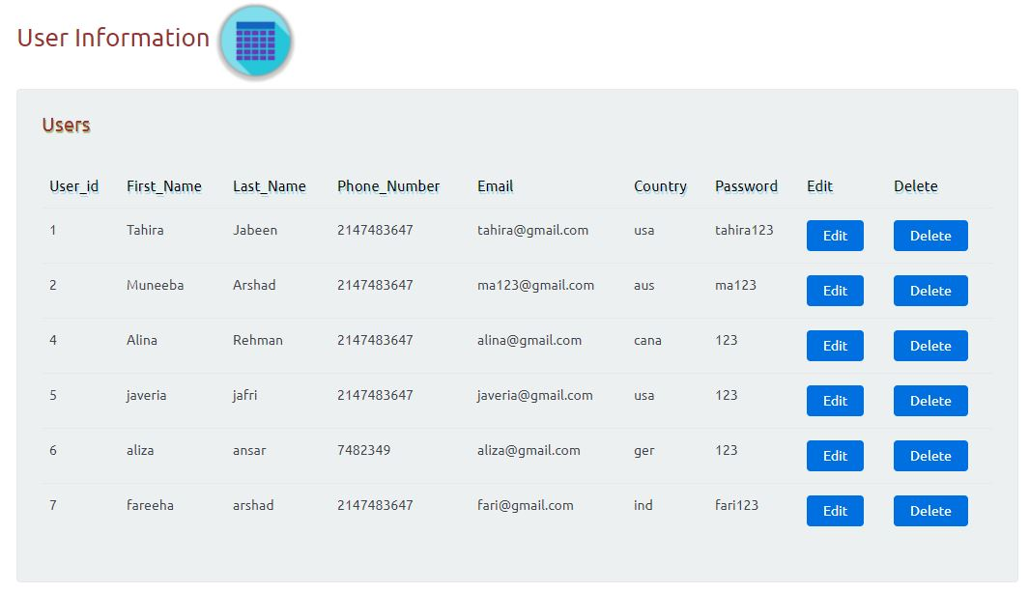
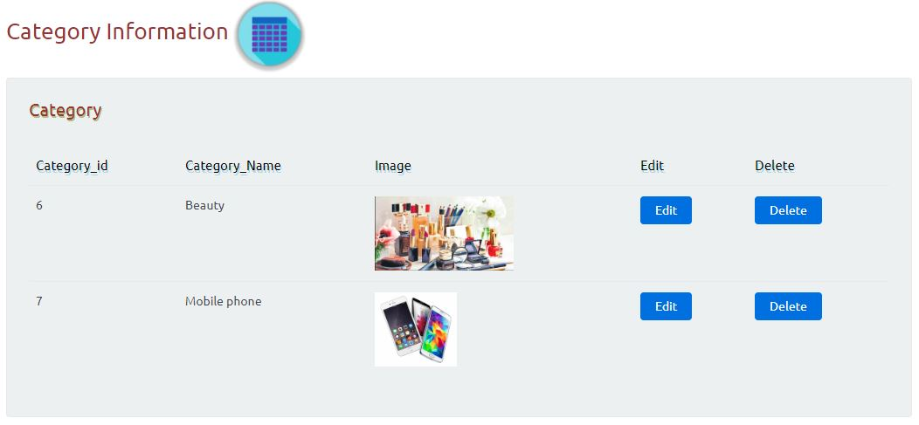
Admin Panel
_______________________________
_______________________________
FYP Proposal Presentation
36
36

Slide 37
Future Work
_______________________________
we can shift this web application on Android with better user interface by introducing more attractive features for the better understanding of users.
_______________________________
FYP Proposal Presentation
37
37

Slide 38
References
_______________________________
[1] https://www.nltk.org/install.html
[2] https://archive.ics.uci.edu/ml/index.php
[3] https://www.amazon.com/
[4] https://www.khanacademy.org/math/statistics-probability/inference-categorical-data-chi- square-tests/chi-square-goodness-of-fit-tests/v/pearson-s-chi-square-test-goodness-of-fit
[5] https://www.rankabrand.org/
[6] https://www.daraz.pk/
[7] https://www.agilealliance.org/agile101/
[8] https://towardsdatascience.com/machine-learning-text-processing-1d5a2d638958
[9] https://python-forum.io/Thread-Python-3-8-3-6-3-7-and-pip-installation-under-Windows
[10] https://brand24.com/blog/sentiment-analysis/
[11] https://www.kaggle.com/
[12] https://www.youtube.com/watch?v=Uh2ebFW8OYM
[13] https://github.com/aesuli/sentiwordnet
_______________________________
FYP Proposal Presentation
38
38

